Slide 1
Avoid information leakage while doing AI in bioinformatics
Helmholtz Institute for Pharmaceutical Research Saarland and Saarland University
Brussels, January 2026

Slide 2

Who am I
Professor for drug bioinformatics, Uni Saarland & HIPS
M.Sc. in mathematics
Ph.D. in molecular biology
Habilitated venia legendi bioinformatics
Bluesky @ok55991.bsky.social

Slide 3
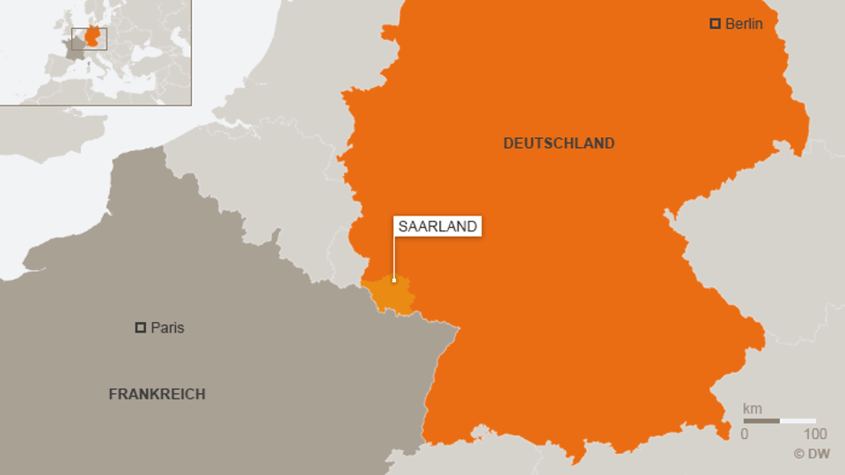


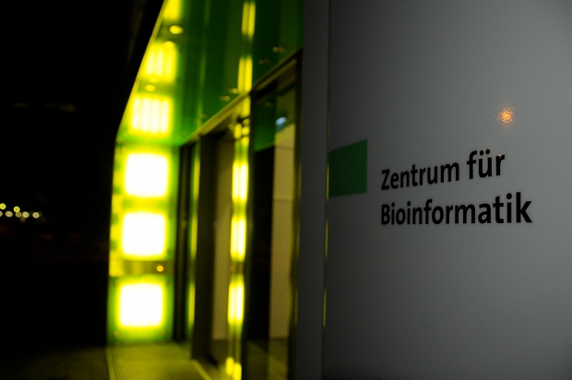
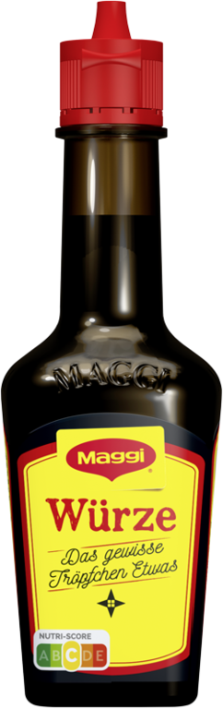
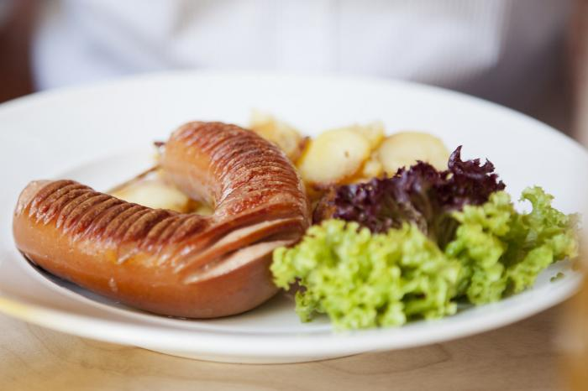


Research group “Drug bioinformatics” @Uni Saar

Slide 4

Center for Bioinformatics, Uni Saar
Full Bachelor + Master of bioinformatics study program (1 of 8 in Germany)
77 Bachelor, 221 Master students
Bachelor in taught in German
Master in English => 90 % international
5 full professor chairs + 2 junior groups
From algorithms to clinical bioinformatics to AI-driven drug discovery

Slide 5
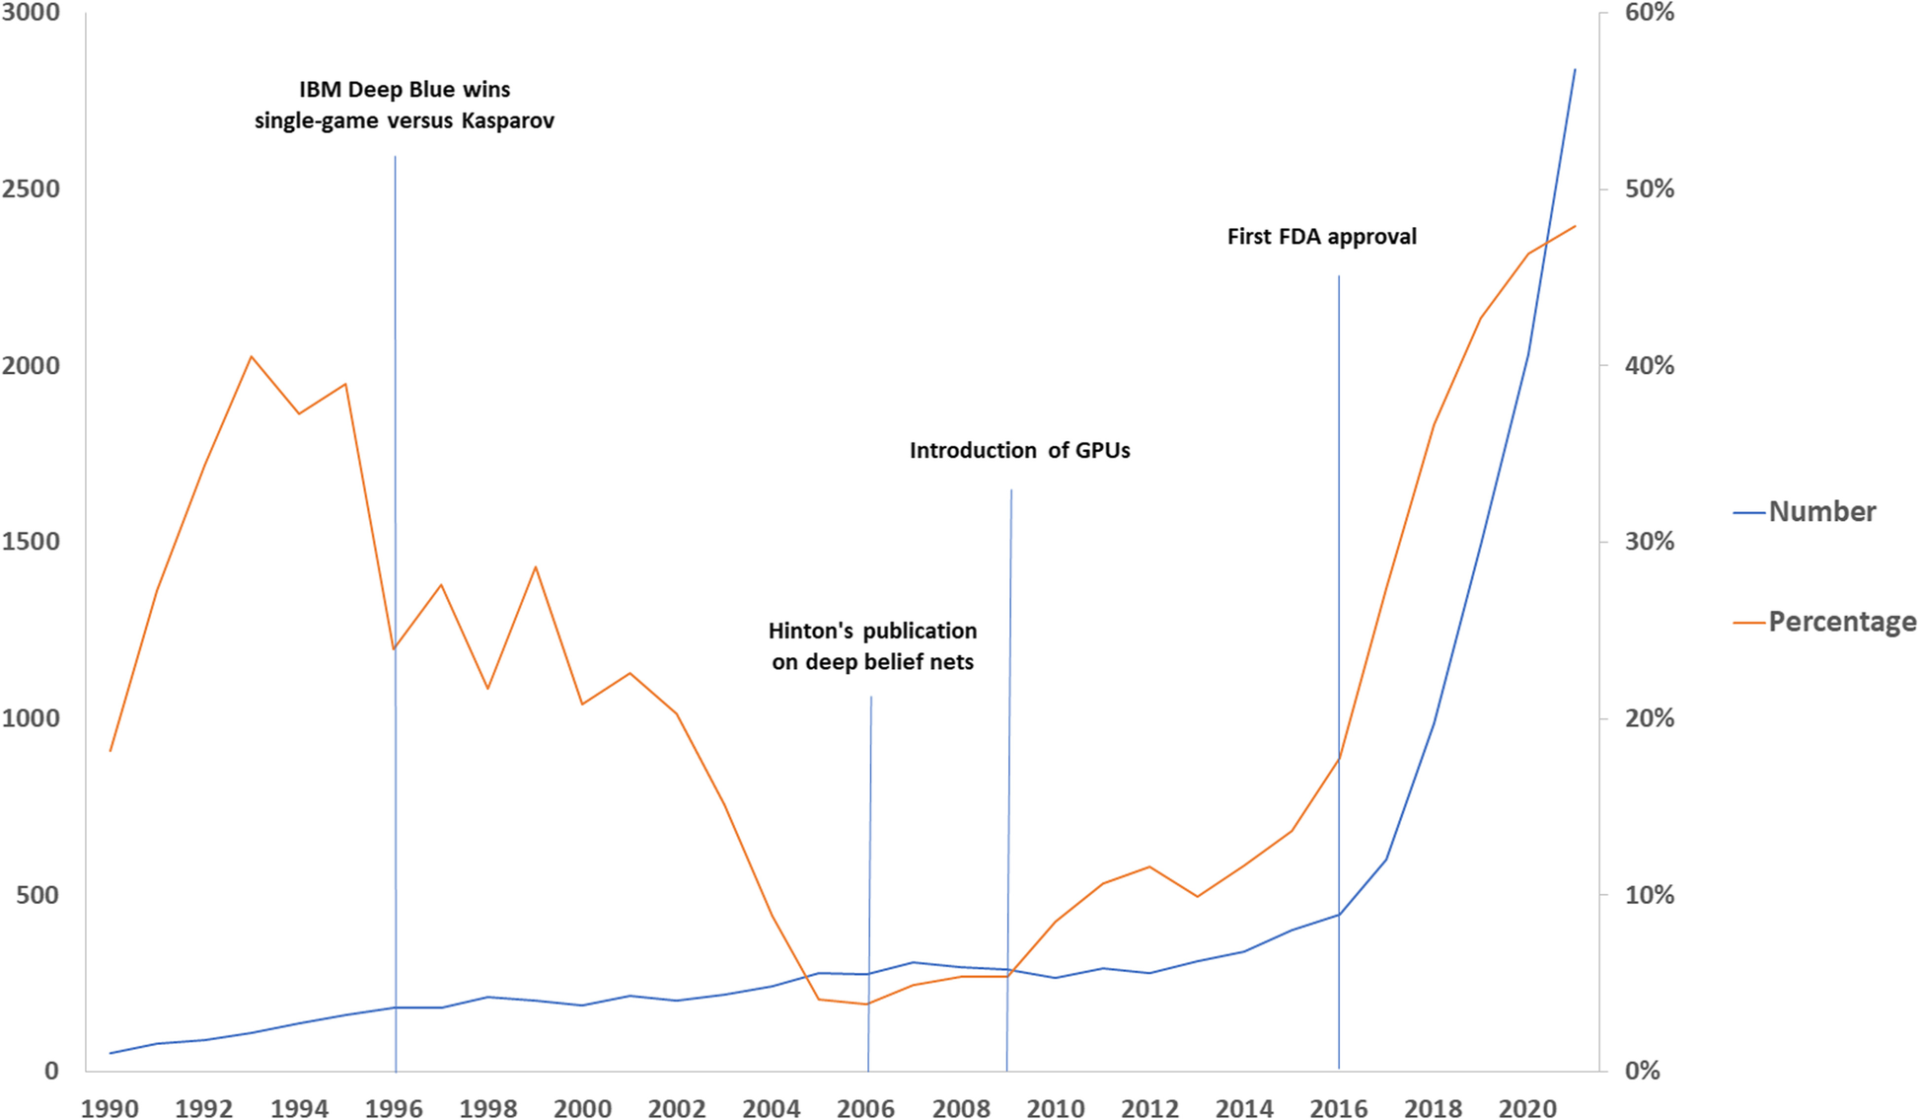
ML in biomedical research
*
“Number of articles on artificial intelligence (AI) in the field of medical imaging and percentage of those declaring the use of AI in the title.”
Sardanelli, F., Castiglioni, I., Colarieti, A. et al. Eur Radiol Exp 7, 2 (2023). https://doi.org/10.1186/s41747-022-00316-7
* of a software for analysing magnetic resonance cardiovascular images

Slide 6
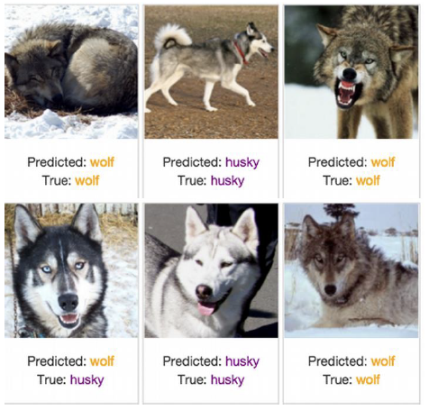
Black-box models: can we trust them?
Ribeiro, M. T., Singh, S., & Guestrin, C. (2016). " Why should I trust you?" Explaining the predictions of any classifier. In Proceedings of the 22nd ACM SIGKDD international conference on knowledge discovery and data mining (pp. 1135-1144).
Only one error

Slide 7
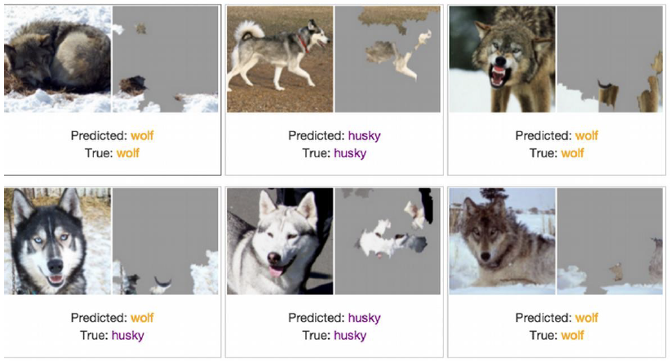
Black-box models: can we trust them?
Ribeiro, M. T., Singh, S., & Guestrin, C. (2016). " Why should I trust you?" Explaining the predictions of any classifier. In Proceedings of the 22nd ACM SIGKDD international conference on knowledge discovery and data mining (pp. 1135-1144).
Only pixels contributing to prediction are shown on the right
We built a perfect snow detector!

Slide 8
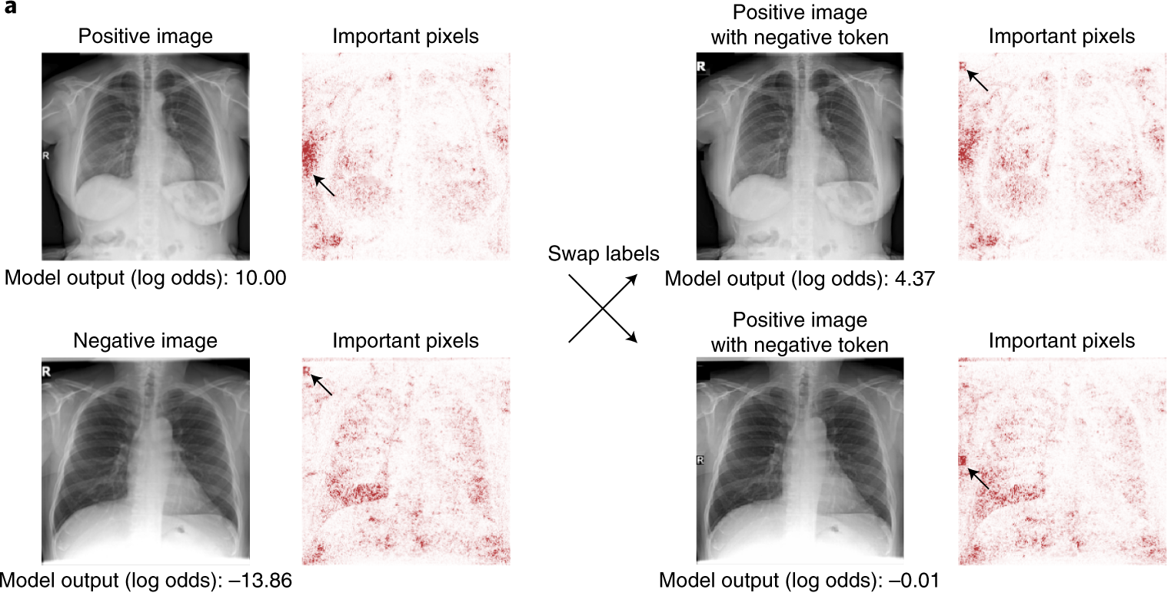
It’s all fun and games until it isn’t: diagnosing COVID-19
DeGrave, A.J., Janizek, J.D. & Lee, SI. (2021). AI for radiographic COVID-19 detection selects shortcuts over signal. Nat Mach Intell 3, 610–619
“…text markers on radiographs are highlighted by saliency maps as important for COVID-19 prediction. The exchange of laterality markers between a pair of COVID-19-positive and COVID-19-negative images significantly shifts the output when compared to swapping random patches of the same size.”

Slide 9
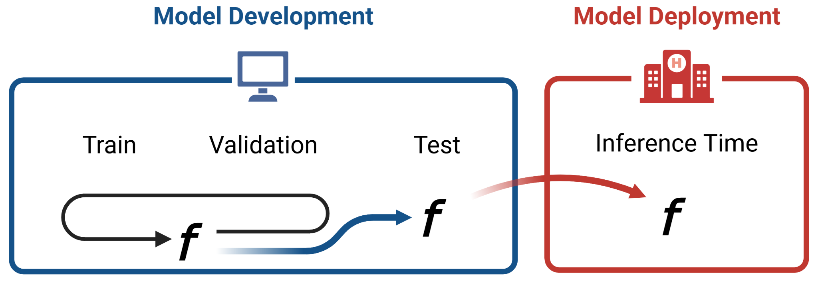
Information leakage in biomedical research

Slide 10
Information leakage
Use of information during a model’s training process that would not be available during inference => overestimated performance
Feature leakage (column-wise): highly correlated (duplicate) features, e.g. “monthlySalary” and “yearlySalary”
Training example leakage (row-wise): sharing information between samples
Duplicate samples (oversampling)
Premature featurization
Non-i.d.d. data (time-series leakage, group leakage)
--Wikipedia
Features →
 |  |  |  |  |  |  |  | …
 |  |  |  |  |  |  |  | …
 |  |  |  |  |  |  |  | …
 |  |  |  |  |  |  |  | …
 |  |  |  |  |  |  |  | …
 |  |  |  |  |  |  |  | …
… | … | … | … | … | … | … | … | …
← Samples

Slide 11
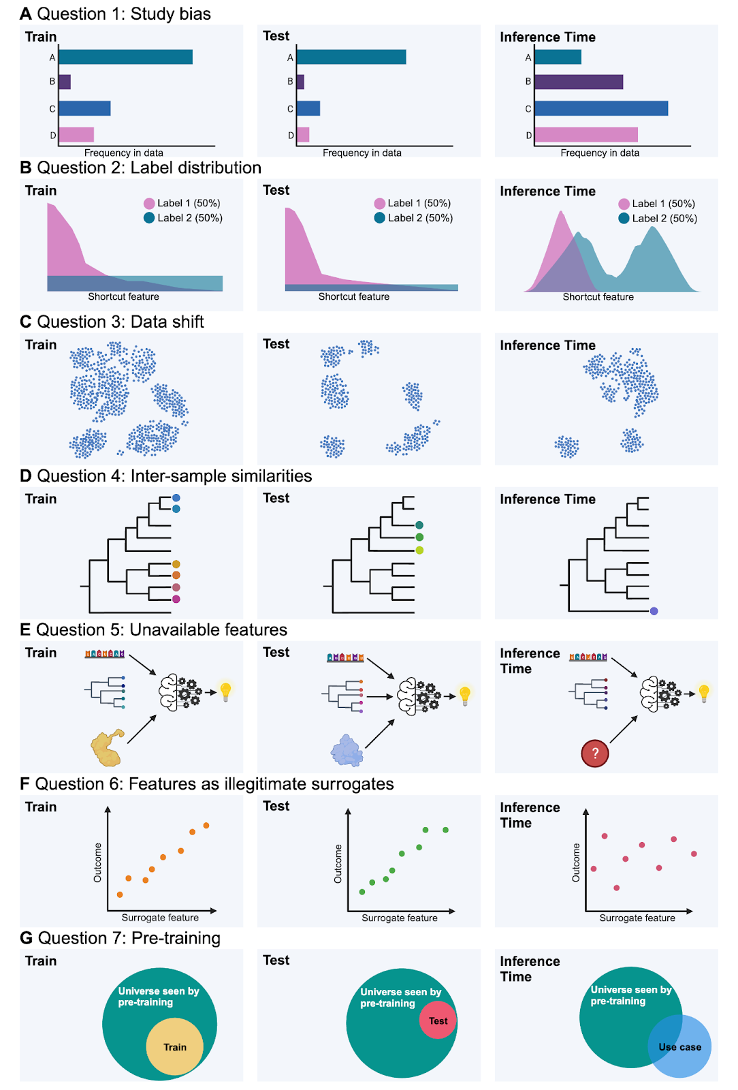
Detecting information leakage
Study bias: Are classes over-/understudied compared to inference time?
Label distribution: Are the labels in test differently distributed to inference?
Data shift: Are the samples used for developing representative of the samples at inference time?
Inter-sample similarities: Are there (possibly hidden) similarities/ dependencies in the development data that are not given for the inference data?
Unavailable features: Do you use features that do not exist for the inference data?
Features as illegitimate surrogates: Does feature engineering affect performance at test and inference time?
Pre-training: Does pre-training data leak information about test but not inference data?
Bernett, Blumenthal, Grimm, Haselbeck, Joeres, Kalinina, List. Nature Methods (2024)

Slide 12
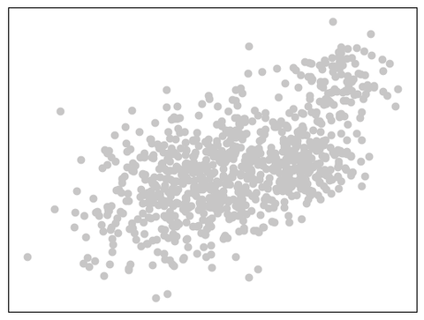
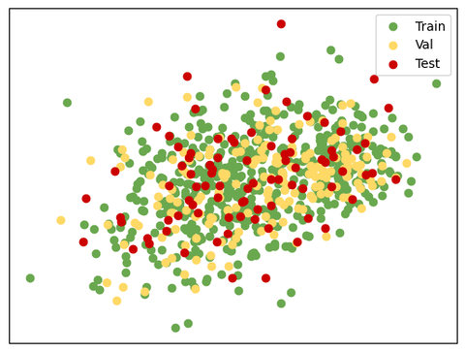
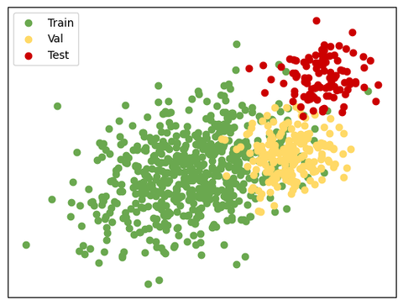
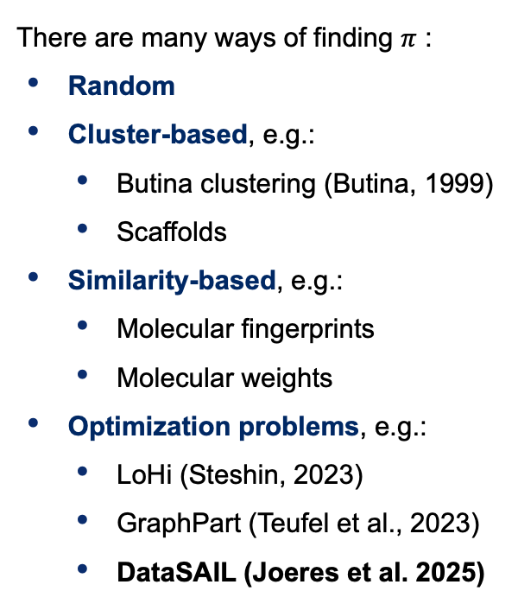
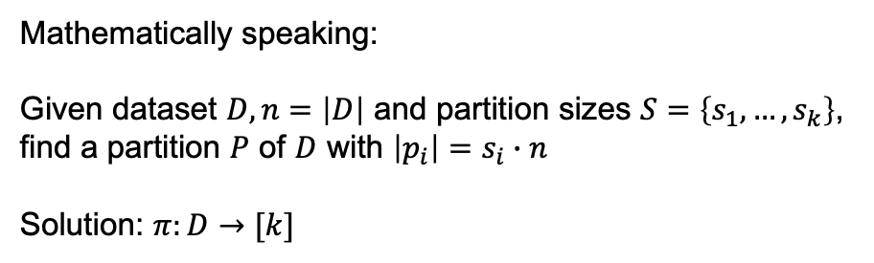
Data splits
There are many ways of finding $π$ :
Random
Cluster-based, e.g.:
Butina clustering (Butina, 1999)
Scaffolds
Similarity-based, e.g.:
Molecular fingerprints
Molecular weights
Optimization problems, e.g.:
LoHi (Steshin, 2023)
GraphPart (Teufel et al., 2023)
DataSAIL (Joeres et al. 2025)
Mathematically speaking: Given dataset $D, n=\left|D\right|$ and partition sizes $S=\left\{s_{1},…,s_{k}\right\}$, find a partition $P$ of $D$ with $\left|p_{i}\right|=s_{i}∙n$
Solution: $π:D→[k]$
Dataset
Partitioning 1
Partitioning 2

Slide 13
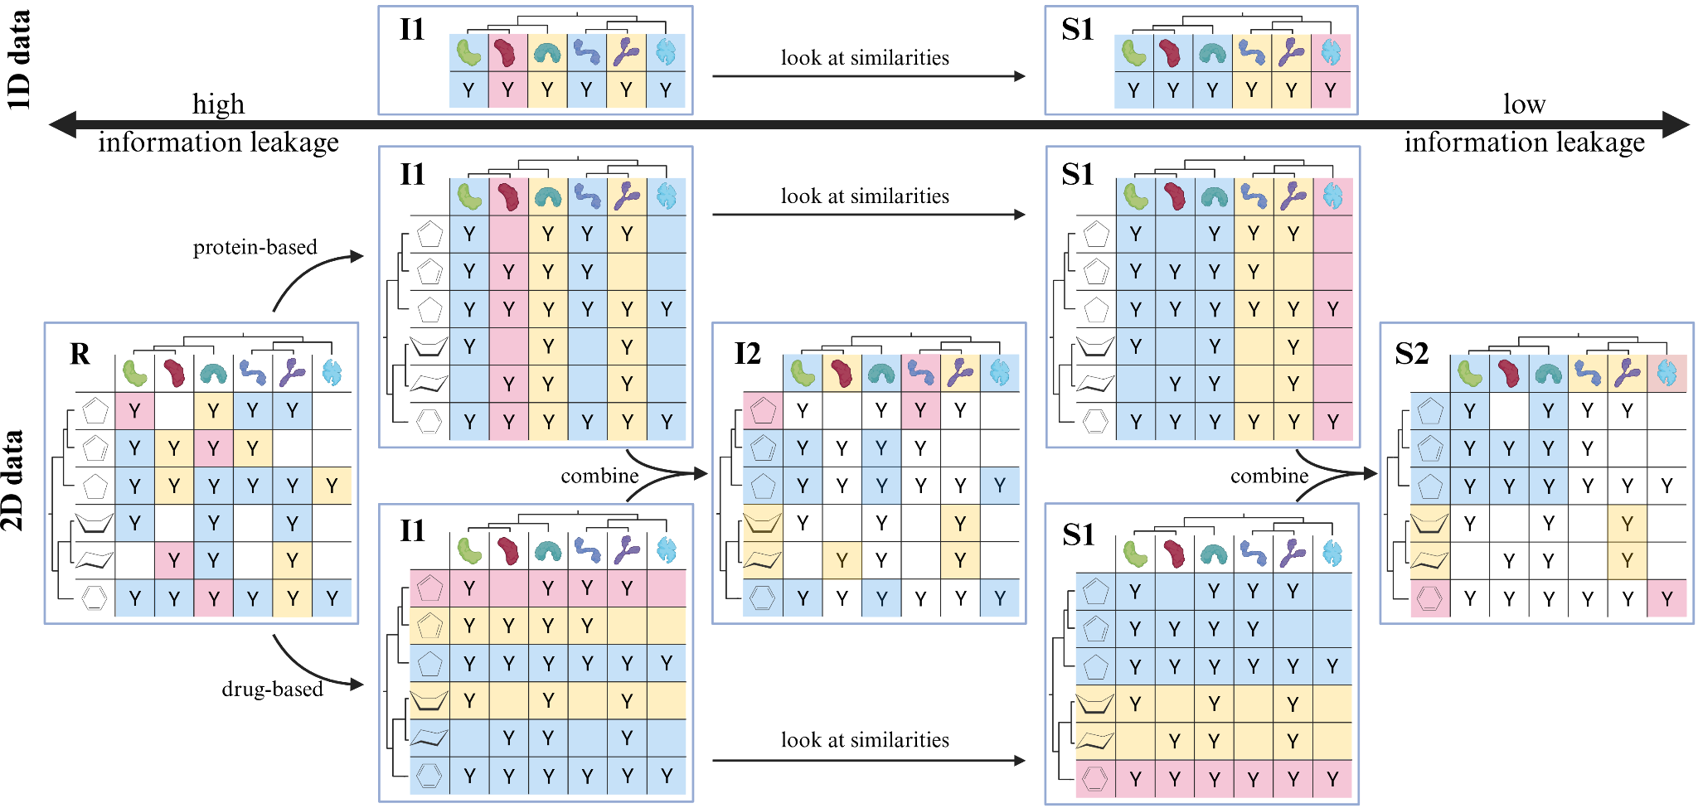
Data splits

Slide 14
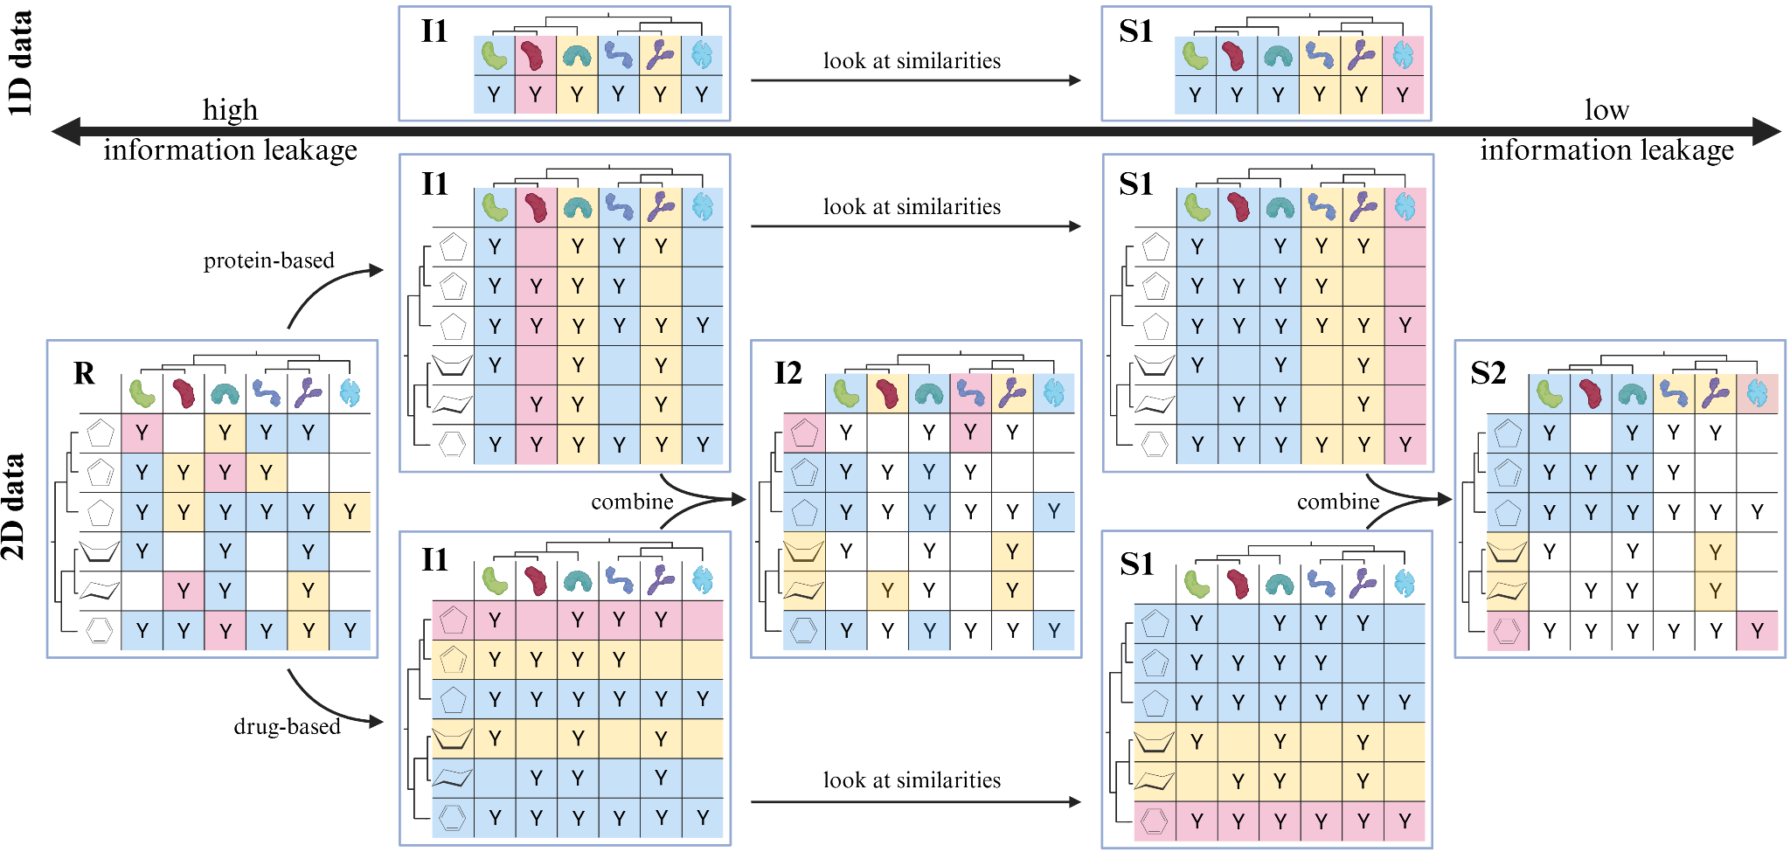

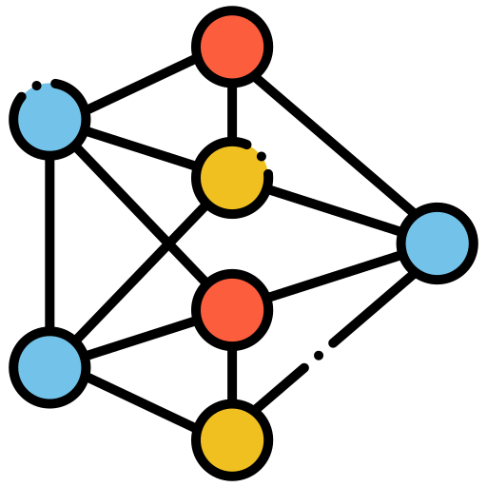

Controlling data leakage with clever data splits
Memorizing
Generalizing
train
test
train
test
3.1415
2.7183
DataSAIL fights information leakage and helps train generalizing models
3.0139
0.1293
3.1828
-0.2948
3.1828
-0.2948
ground truth

Slide 15
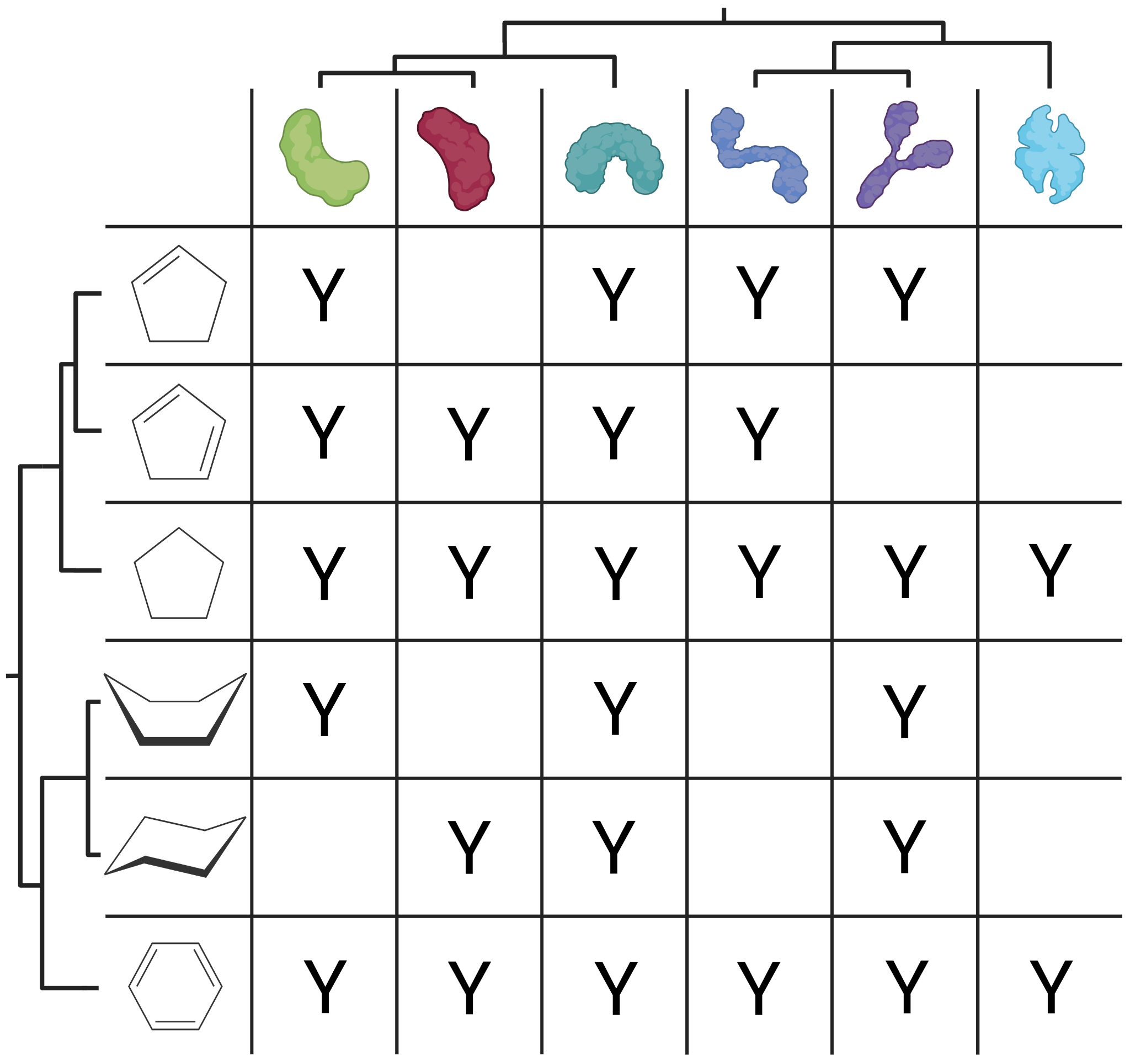

Drug-target interaction prediction model
Yes/No, or
Type of binding, or
Strength of binding

Slide 16
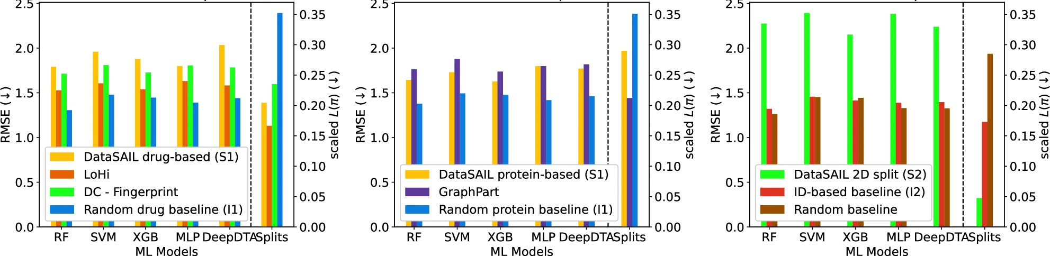
Drug-target interaction prediction model
Yes/No, or
Type of binding, or
Strength of binding
Performance for the LP-PDBBind dataset

Slide 17
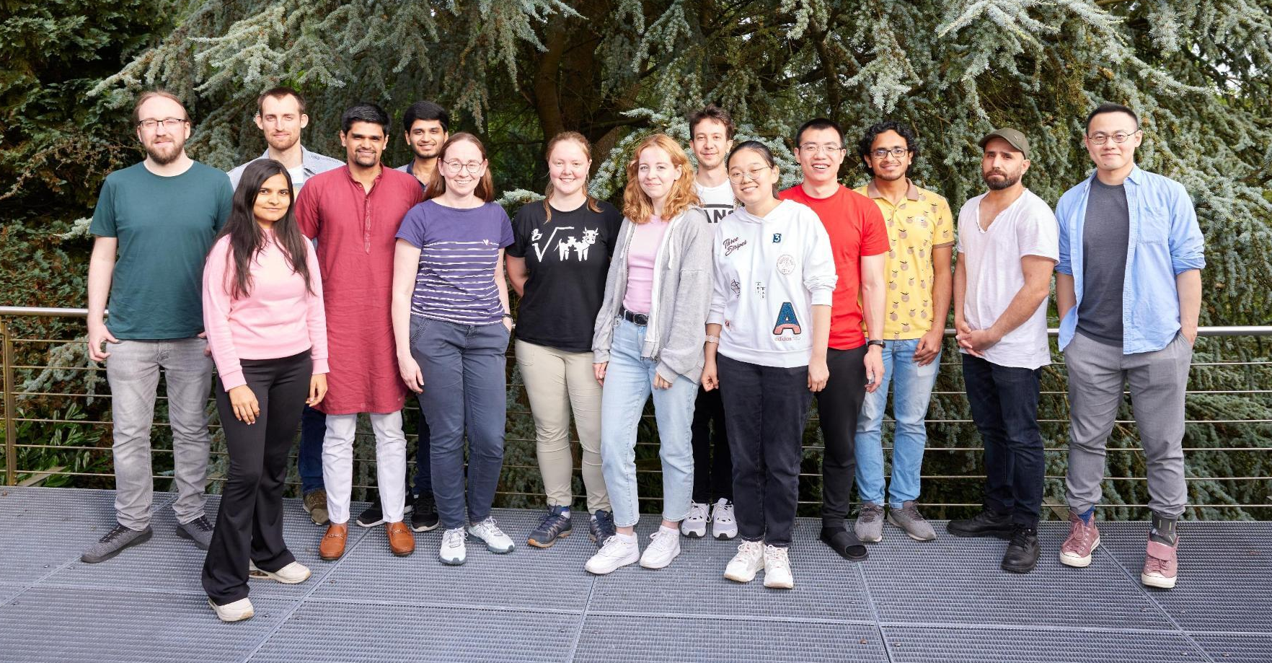
Conclusions
Data leakage is a major problem in predictive models
It can and should be addressed before the model is trained
Better (more generalizable) models may show poorer performance in benchmarks
Thank you for listening!
Questions?

